Slide 1
Exploratory Data Analysis
Present by : Rahul Makwana

Slide 2
Introduction of EDA :-
Exploratory Data Analysis(EDA) is the main step in the process of various data analysis.
It helps data to visualize the patterns, characteristics, and relationships between variables.
Python provides various libraries used for EDA such as NumPy, Pandas, Matplotlib, Seaborn.
EDA is a phenomenon under data analysis used for gaining a better understanding of data aspects like:
1. main features of data
2. variables and relationships that hold between them
3. Identifying which variables are important for our problem

Slide 3
Basic steps of EDA :-
Reading dataset
Analysing the data
Checking for the duplicates
Missing Values Calculation
Exploratory Data Analysis :-
1) Univariate Analysis
2) Bivariate Analysis
3) Multivariate Analysis

Slide 4
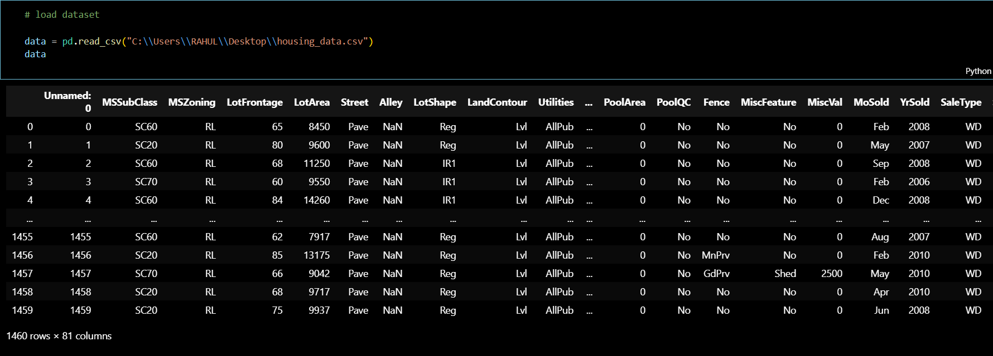
Example of Real Estate Pricing using EDA :-
Loading a dataset of the real estate pricing dataset

Slide 5
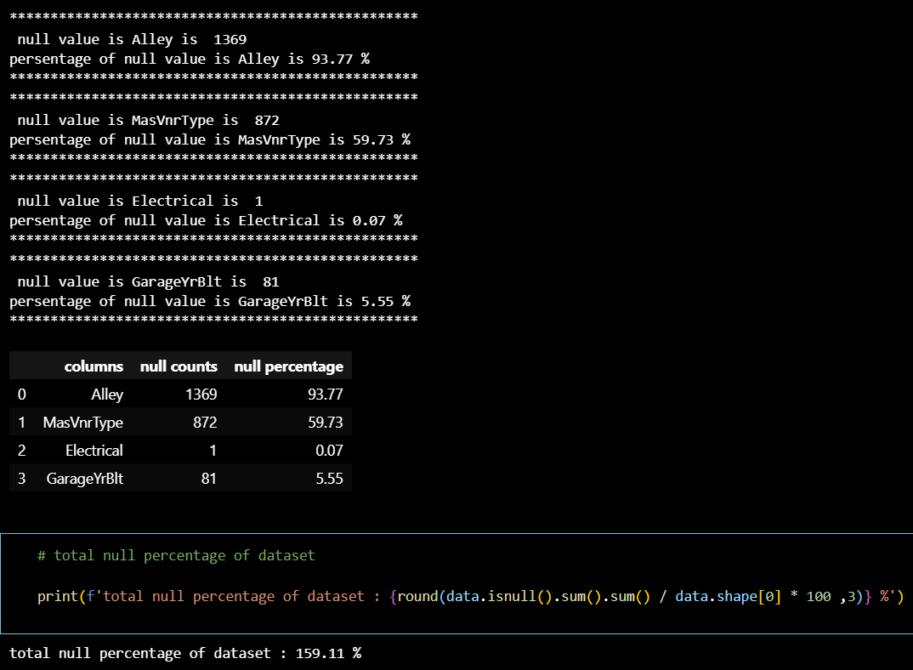
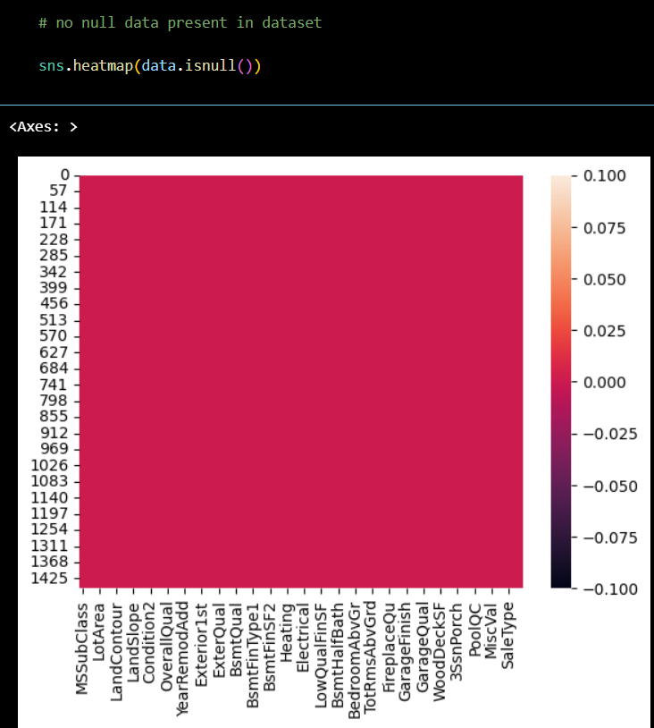
Data cleaning process :-
Total null value in percentage
After processing no null present

Slide 6
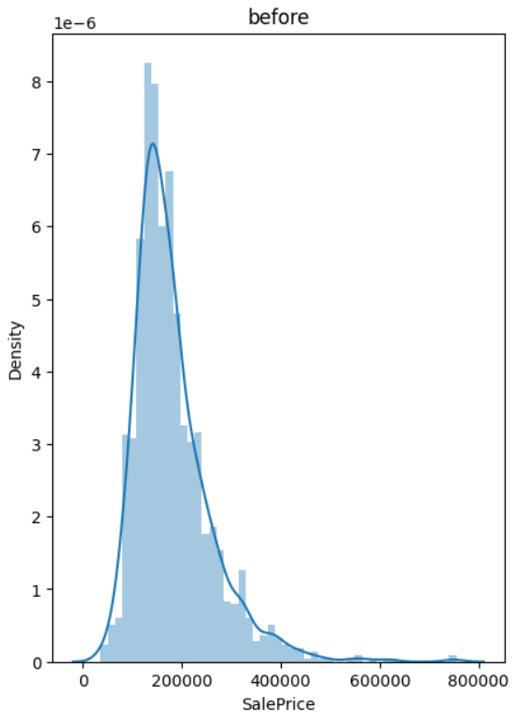
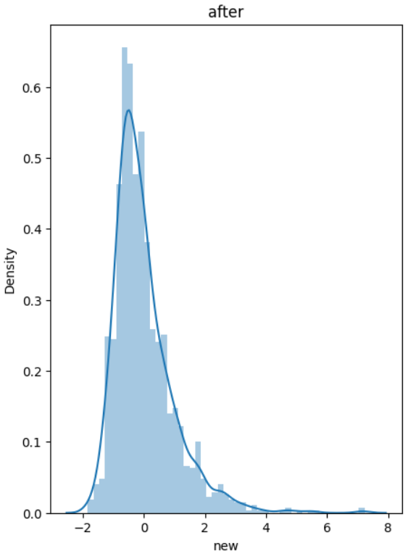
Feature engineering :-
Before apply of Standardization method and show nature of data in sale price
apply of Standardization method and show nature data of sale price
No change in nature

Slide 7
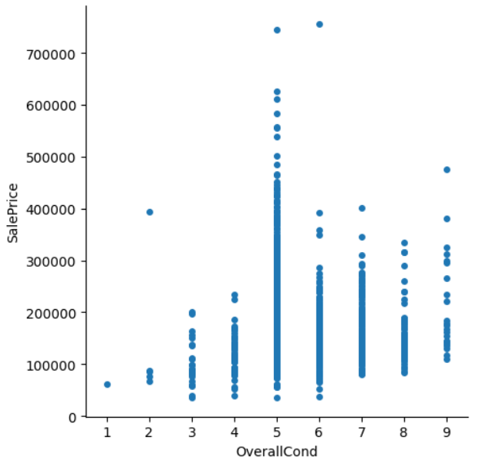
Multivariate Analysis :-
Sale price report of house rating
in show graph find below insights :-
Most no. house sales of 5 rating houses and its price were going in above 7,00,000 /-
Less houses sell of 1 rating house and its price were going in below 1,00,000 /-

Slide 8
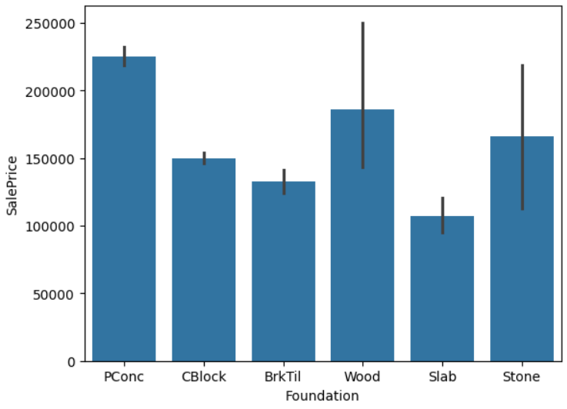
House foundation basis sale report :-
Impact of foundation in sale report of house
in show in graph find below insights :-
PConc means Poured Concrete foundation using in houses so sale price was increase.
In slab foundation using in houses so sale price was decrease.

Slide 9
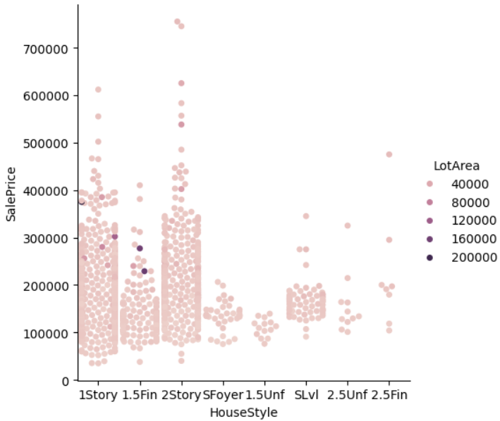
Sale price report of housestyle and lotarea :-
House lotarea and housestyle sale report :-

Slide 10
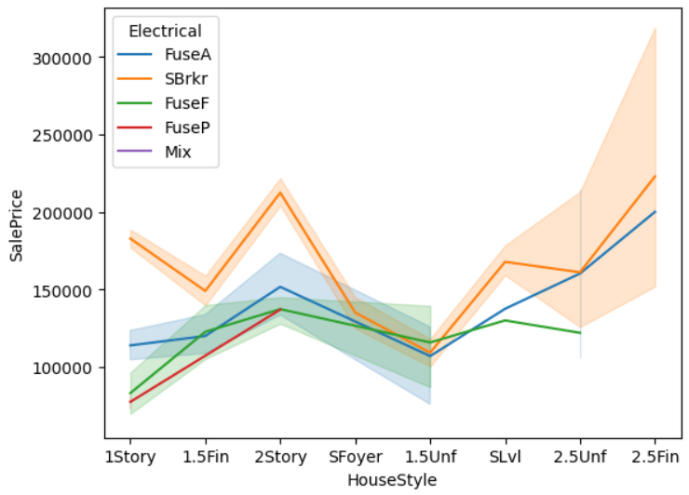
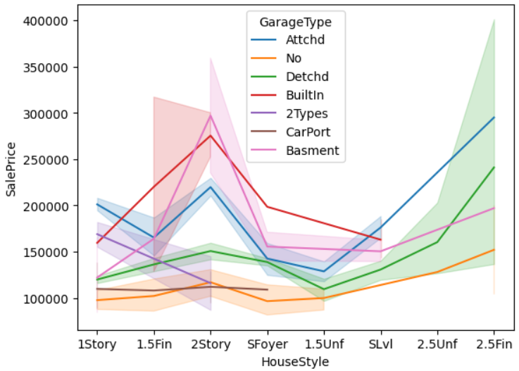
Amenities impact in house sale Price :-
Electrical system basis house sale price report
Garage type basis house sale price report

Slide 11
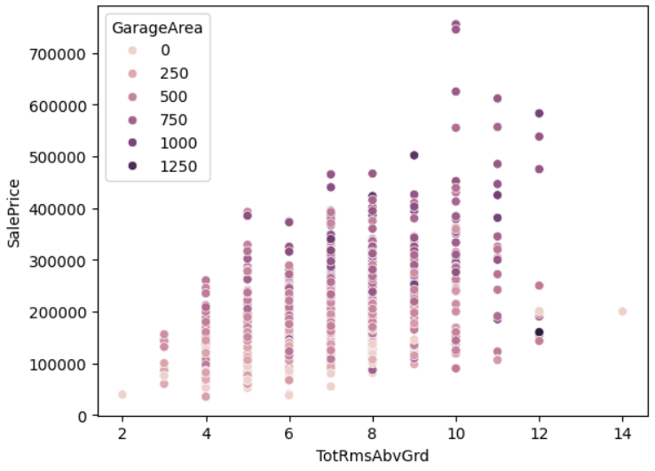
Sale report of total rooms and garage area :-
What is impact of Garage area and total rooms in sale report show in scatter plot ?

Slide 12
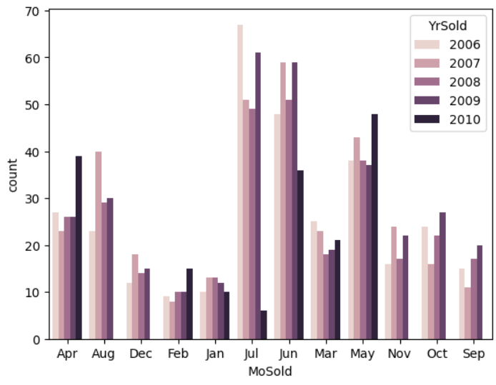
Sale report of months and years wise :-
which can find No. sale houses sale in months and years show in graph

Slide 13
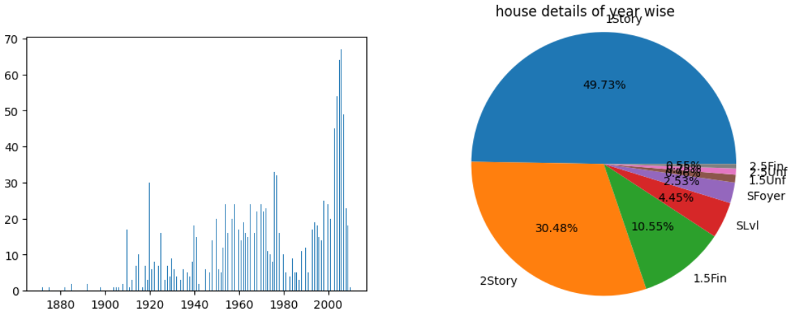
House selling details of year wise :-
House selling in year and house style house sell percentage report :-

Slide 14
Conclusion :-
we have apply EDA data analysis technique so find below insights in dataset
We have apply in different data visualization technique in sale price of house in dataset so many insights found in different amenities.
if customer house purchase in amenities basis so data visualization technique very helpful for customer requirements.
We have learn in how to apply EDA data analysis in dataset and how to find insights of problem statement.
We have also summaries of sale report in different amenities

Slide 15
Thank you

